Slide 1
Multi-Level Tree Structured Indexing

Slide 2
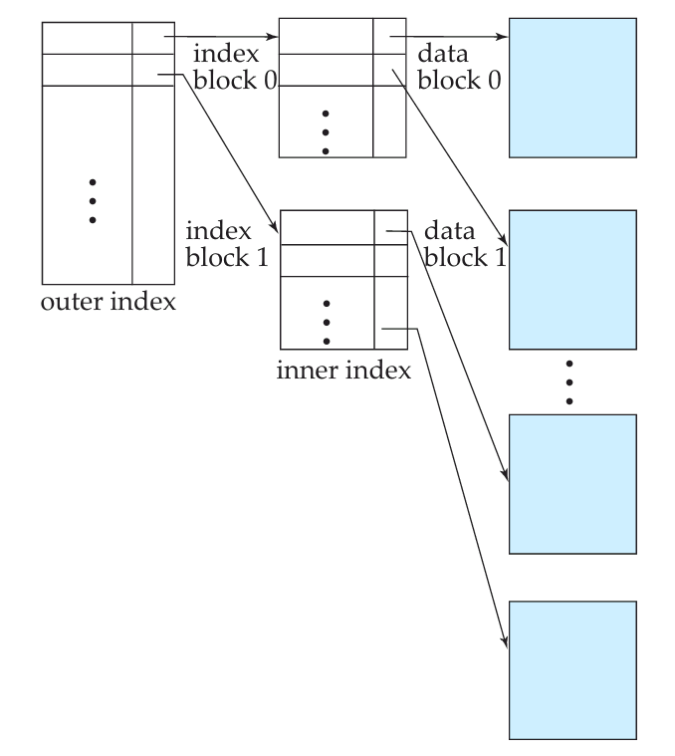

Slide 3
The idea behind a multilevel index is to reduce the part of the index that we continue to search by (bfr) the blocking factor for the index, which is larger than 2.
Whereas we divide the record search space into n-ways at each search step using the multilevel index.
A multilevel index considers the index file, which we will now refer to as the first (or base) level of a multilevel index, as an ordered file with a distinct value for each K(i). Therefore, by considering the first-level index file as a sorted data file, we can create a primary index for the first level; this index to the first level is called the second level of the multilevel index.

Slide 4
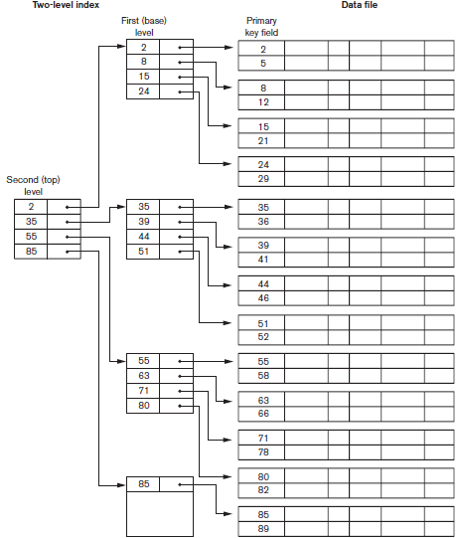

Slide 5
A common file organization used in business data processing is an ordered file with a multilevel primary index on its ordering key field. Such an organization is called an indexed sequential file and was used in a large number of early IBM systems.
IBM’s ISAM organization incorporates a two-level index that is closely related to the organization of the disk in terms of cylinders and tracks.

Slide 6
To retain the benefits of using multilevel indexing while reducing index insertion and deletion problems, designers adopted a multilevel index called a dynamic multilevel index that leaves some space in each of its blocks for inserting new entries and uses appropriate insertion/deletion algorithms for creating and deleting new index blocks when the data file grows and shrinks.
It is often implemented by using data structures called
  B-trees
  B+-trees

Slide 7
Tree Concepts:
A tree is formed of nodes. Each node in the tree, except for a special node called the root, has one parent node and zero or more child nodes.
The root node has no parent. A node that does not have any child nodes is called a leaf node.
A non-leaf node is called an internal node. The level of a node is always one more than the level of its parent, with the level of the root node being zero.
Subtree of a node consists of that node and all its descendant nodes : its child nodes, the child nodes of its child nodes, and so on.
Since the leaf nodes are at different levels of the tree, this tree is called unbalanced.

Slide 8
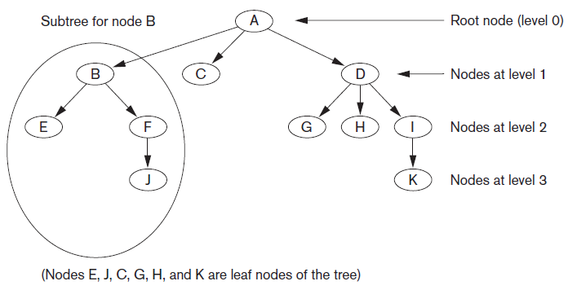

Slide 9
Search Trees
A search tree is a special type of tree that is used to guide the search for a record, given the value of one of the record’s fields.
Variation of a search tree
A search tree of order p is a tree such that each node contains at most p − 1 search values and p pointers in the order <P1, K1, P2, K2, ..., Pq−1, Kq−1, Pq>, where q ≤ p.
Each Pi is a pointer to a child node (or a NULL pointer), and each Ki is a search value from some ordered set of values. All search values are assumed to be unique.

Slide 10
Two constraints must hold at all times on the search tree:
  Within each node, K1 < K2 < ... < Kq−1.
  For all values X in the subtree pointed at by Pi, we have Ki−1 < X < Ki
  for 1 <i < q; X < Ki for i = 1; and Ki−1 < X for i = q.

Slide 11
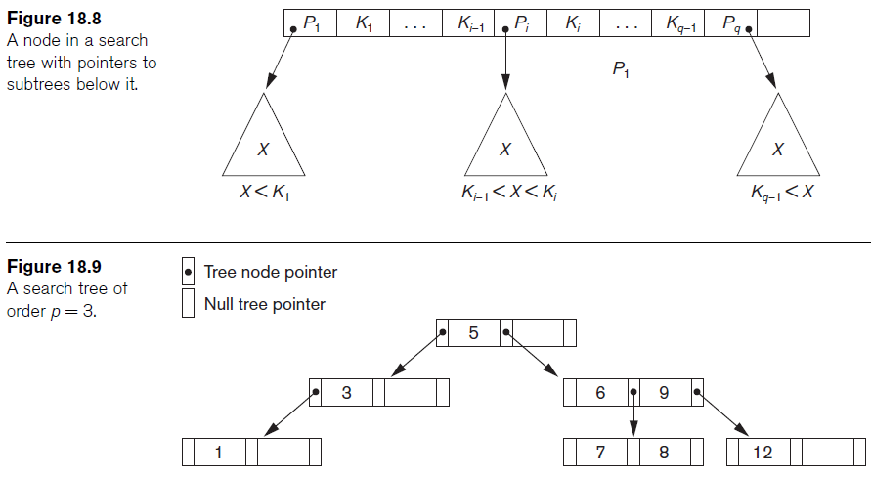

Slide 12
B-Trees
The B-tree has additional constraints that ensure that the tree is always balanced and that the space wasted by deletion, if any, never becomes excessive.
The algorithms for insertion and deletion, though, become more complex in order to maintain these constraints.
Whenever we attempt an insertion into a node that is already full or a deletion from a node that makes it less than half full, it becomes complicated.

Slide 13
A B-tree of order p, when used as an access structure on a key field to search for records in a data file, can be defined as follows:
Each internal node in the is of the form <P1, <K1, Pr1>, P2, <K2, Pr2>, ..., <Kq–1, Prq–1>, Pq> where q ≤ p.
  Each Pi is a tree pointer—a pointer to another node in the Btree.
  Each Pri is a data pointer—a pointer to the record whose search key field value is equal to Ki (or to the data file block containing that record).
Within each node, K1 < K2 < ... < Kq−1.
For all search key field values X in the subtree pointed at by Pi the ith subtree, we have:
Ki–1 < X < Ki for 1 < i < q; X < Ki for i = 1; and Ki–1 < X for i = q.
Each node has at most p tree pointers

Slide 14
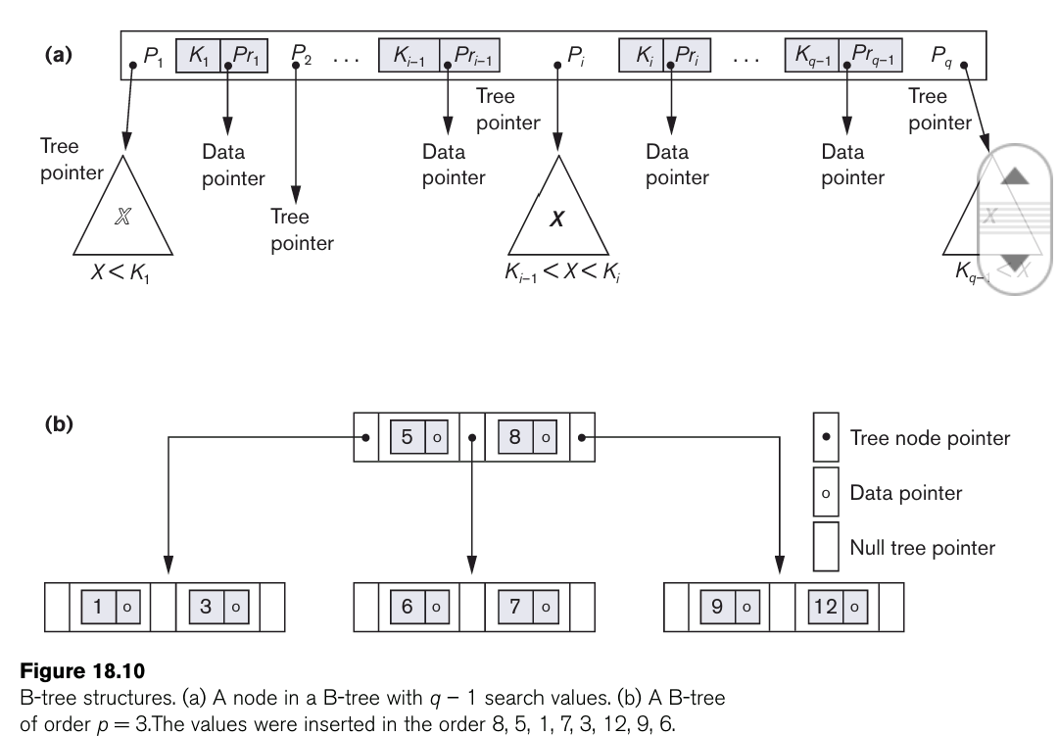

Slide 15
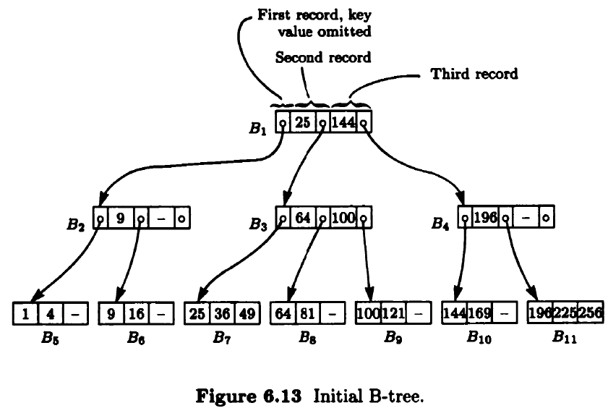

Slide 16
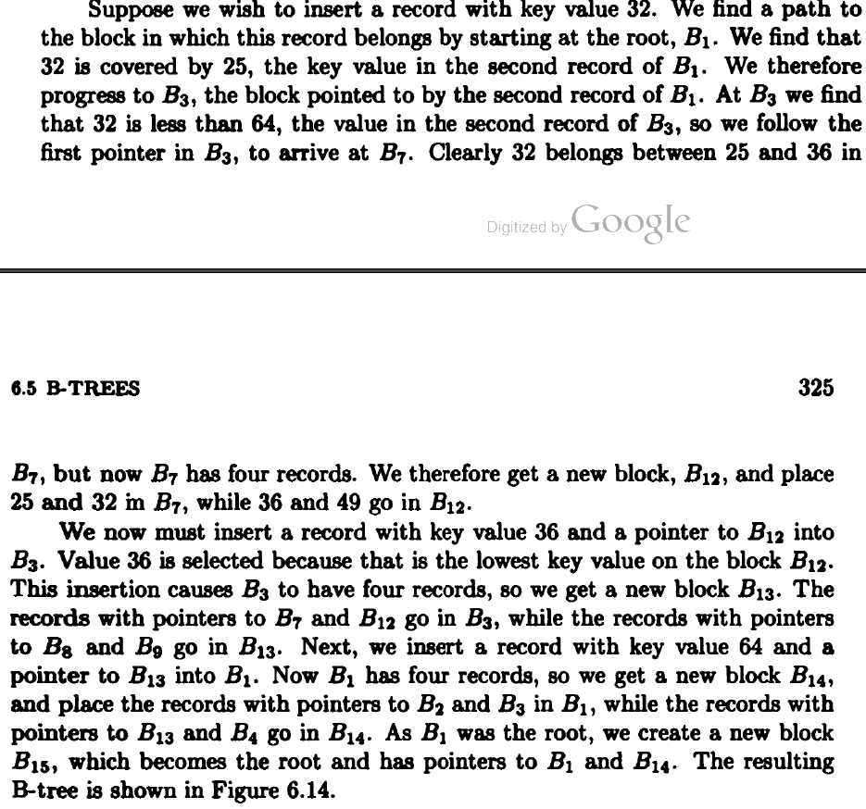

Slide 17
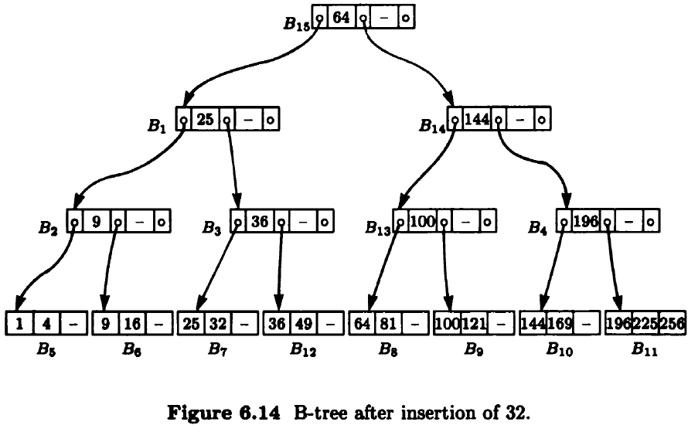

Slide 18
